Slide 1
Unit 8
Theories of the world economy: colonialism, neocolonialism and imperialism

Slide 2
Preface
This is to be presented in the final class
The class combines units 8 and 9
Nobody has chosen this as an essay topic
So we will be more sketchy than previous classes
This is a huge topic
So is Unit 9 (on theories of socialism)
I have included much supplementary reading
I will try to summarise the key debates and leave you to do the reading

Slide 3
What we will cover
The structure of the modern inequality of nations: a statistical overview
The Third International and the colonial question
Neocolonialism; dependency theory; Unequal exchange
Baran and Sweezy and the Monthly Review school
Brenner’s choice; the Eurocentric origins of modern economics
Mandel’s Late Capitalism: an integrated treatment of crisis in the modern world economy, and the central role of surplus profit
Volume III as the basis for class analysis; the propertied classes as recipients of shares of surplus value based on different forms of property
The imperialist nation-state and the monopolisation of specific sources of surplus profit. Types of imperialist state.

Slide 4
The inequality of nations
A persistent problem that has not been well explained

Slide 5
Why does inequality persist?
In 1917, the gap between the poorest and richest nations was smaller than today: about 7:1
Since then it has systematically grown (Pritchett “The Great Divergence”)
In addition, inequality seems to be growing within each nation
Why?

Slide 6
Do nations matter=?
Milanovic, Sala-i-Martin
National inequality doesn’t matter
We just measure ‘all rich people’ and ‘all poor people’ and look at the gap between them
Note also that Picketty does not really consider differences between nations
However:
The ratio of the average income of the advanced and third-world countries, by 1990, was 25:1
This has a major effect on inequality within nations
The rich classes tend towards income levels that compare with incomes in the rich countries
There is a pattern of the division of the world that consigns poor nations to be ‘low wage resource-based’ economies.
This keeps wages low and makes them dependent on imported capital goods
So inequality between nations cannot be ignored

Slide 7
Some facts about national inequality
(repeats some of unit 7)
After the second world war, it declined until about 1980
The Soviet Union became a ‘second-tier’ economy
Countries like India that achieved independence grew relatively faster
Mexico was a second-tier economy
A very small group (Malaysia, etc) became middle-income
In 1980 this went into reverse
The ‘inequality ratio’ sank from 1:10 down to 1:25
In 1990 this began to change and by 2000 switched back again
Almost entirely because of China
But other countries began to grow faster (Vietnam, East Africa)
And the West was stagnating
The ‘BRICS’ emerged

Slide 8
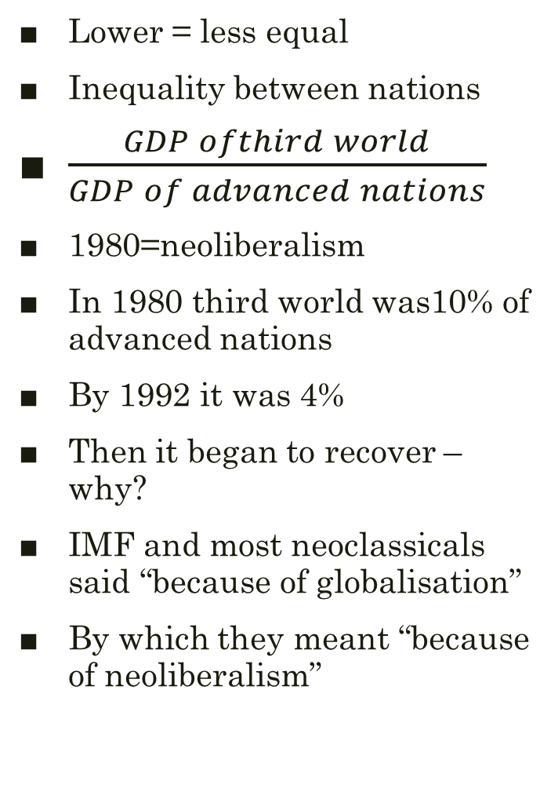
World Inequality
Lower = less equal
Inequality between nations
$\frac{GDP ofthird world}{GDP of advanced nations}$
1980=neoliberalism
In 1980 third world was10% of advanced nations
By 1992 it was 4%
Then it began to recover –why?
IMF and most neoclassicals said “because of globalisation”
By which they meant “because of neoliberalism”

Slide 9
Two causal stories

Slide 10
China’s effect, without PPP distortion
Almost the entire reduction is due to China
Outside China, the reduction begins in 2004
Which is when China is beginning to affect other country growth

Slide 11
The Third International’s theory of Imperialism
Often people just speak of Lenin
Important, but much analysis was common to the Communist Movement
High point was Roy’s ‘theses on the national and colonial question’
This is a rich and complex document that should be studied more
Sketchily, we can say the world was divided into three groups
The ‘Robber Barons’ – about 1/5th of the population
The colonial countries, still seeking independence
The semi-colonial countries
The analysis combines economic and political
In particular, economic dependence was imposed by military force and occupation

Slide 12
Neocolonialism
After World War II, colonial independence became widespread but there was still a long battle
Chinese revolution
Korean revolution
Indian Independence
Vietnamese revolution (initially North, then South)
African movements
Note: independence achieved earlier in Latin America
BUT: inequality persisted
Was there an economic cause?

Slide 13
Walt Whitman Rostow
‘Stages of Growth’
Very influential non-Marxist account
Subtitled ‘an anti-communist manifesto’
Proposes ‘development’ is the problem
Third World countries are poor because they are ‘backward’
Strong racist undertones
Ignores political and economic relation of dependency
Many echoes today
The concept of ‘advanced’ economies
Categories of the economy (Primary, Secondary, Tertiary) are developmental, not economic
The idea of the ‘civilizing mission’ of the west
Justification for Humanitarian intervention
American exceptionalism

Slide 14
Marxism and development
Rostow view finds uncritical support among many western Marxists
It seems to fit with Marx’s theory of stages of history
Eurocentrism
Long debates about whether Nations are ‘precapitalist’
Can a nation ‘leap stages’ of development?
The theory of Combined and Uneven Development
By using the state, poorer or dependent countries could ‘catch up and overtake’
But the question is how to use the state

Slide 15
Dependency Theory
‘The Development of Underdevelopment’
Unequal Exchange
Economic asymmetry
Import substitution
These are only a few of many complex ideas
The central idea is that dependency is imposed
The question remains open: what is the relation between the economic and the political aspects of domination?

Slide 16
Brenner ‘neo-Smithian Marxism’
Famous article, attacked Gunder-Frank
Claim is that with relative surplus-value, advanced countries no longer need their colonies
The problem then becomes as stated by Rostow
A pure problem of development

Slide 17
Marx and the ‘rosy dawn’ of capitalism
Capitalism always depends on earlier economic forms
Its growth was intimately bound up with slavery
‘Primitive accumulation’ was actually primitive dispossession
Capitalism needed to acquire a money surplus from the colonies
Marx wrote before imperialism
But was highly critical of colonialism
Denies that it can play a developmental role
Supported Indian independence
Sceptical this could be achieved without developing Indian working class
This is a political, not an economic criterion
Demanded that western working class support independence
‘No nation that enslaves another can ever itself be free’

Slide 18
Mandel and ‘Late Capitalism’
Centres on surplus profit
Argues that national states can mobilise sources of surplus profit
Imperialist countries continue using their states to transfer surplus profit from third world countries
But by ‘economic’ means, reinforced by political intervention
‘Comparative advantage’ is the predecessor
Desai: enforces notion of ‘complementarity’
Guarantees that surplus from free trade will accumulate in the more productive countries
Financial surplus profit drains surplus via capital capture
Instead, requires ‘similarity’, capital controls, and national development
Note also Ha-Joon Chang ‘kicking away the ladder’

Slide 19
Class structure of the imperialist nations
Strong presence of classes tied to overseas domination
Resource extraction
Financial extraction
Used to ‘pay off’ section of the working class
Welfarism and Chamberlain
Belgium and Leopold
Continues today especially extractive and cheap labour industries
But with the crisis of neoliberalism, this class bloc is dissolving
To the right and to the left: a semi-fascist nationalist with a base in the working class eg Trump, new western left eg Sanders, Corbyn, Melanchon, Podemos, Cinque Stelle etc

Slide 20
Class structure of the dependent economies
‘Comprador’ capital has given way to a ‘transnational’ class tied to the internationalisation of finance
But this occurs because of financial liberalisation
Example of Argentina
Large very poor classes
Substantial middle classes reliant
Which benefits from development
But seeks to become integrated into Western circuits of capital
Politically repressive
Usually very corrupt
And very violent against movements of the poor
Especially violent against governments that support the poor
Example of Venezuela

Slide 21
The developmental state
What kind of state can:
Carry out the development of the nation and particularly its poor classes
Resist internal pressure to dismantle developmental protection
Protect economic sovereignty
Protect political sovereignty
How China is seen in the third world
A developmental model, as much as a socialist model
How China is seen in the west
Ambiguous
Seen as an economic threat
But also an economic opportunituy

